Slide 1
Bias and Variance in Machine Learning
By
Dr. S PADMANABHAN

Slide 2
Bias and Variance in Machine Learning
Machine learning is a branch of Artificial Intelligence, which allows machines to perform data analysis and make predictions. However, if the machine learning model is not accurate, it can make predictions errors, and these prediction errors are usually known as Bias and Variance.
In machine learning, these errors will always be present as there is always a slight difference between the model predictions and actual predictions.
The main aim of ML/data science analysts is to reduce these errors in order to get more accurate results.

Slide 3
Errors in Machine Learning?
In machine learning, an error is a measure of how accurately an algorithm can make predictions for the previously unknown dataset. On the basis of these errors, the machine learning model is selected that can perform best on the particular dataset. There are mainly two types of errors in machine learning, which are:
Reducible error and
Irreducible error.

Slide 4
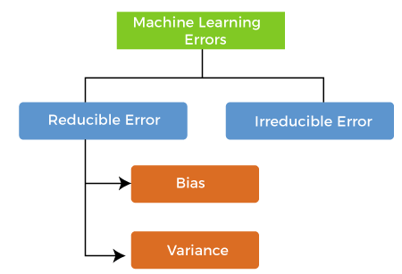
Errors in Machine Learning?

Slide 5
Errors in Machine Learning?
Reducible errors: These errors can be reduced to improve the model accuracy. Such errors can further be classified into bias and Variance.
Irreducible errors: These errors will always be present in the model regardless of which algorithm has been used. The cause of these errors is unknown variables whose value can't be reduced.

Slide 6
What is Bias?
Bias is simply defined as the inability of the model because of that there is some difference or error occurring between the model’s predicted value and the actual value. These differences between actual or expected values and the predicted values are known as error or bias error or error due to bias.
Bias is a systematic error that occurs due to wrong assumptions in the machine learning process.

Slide 7
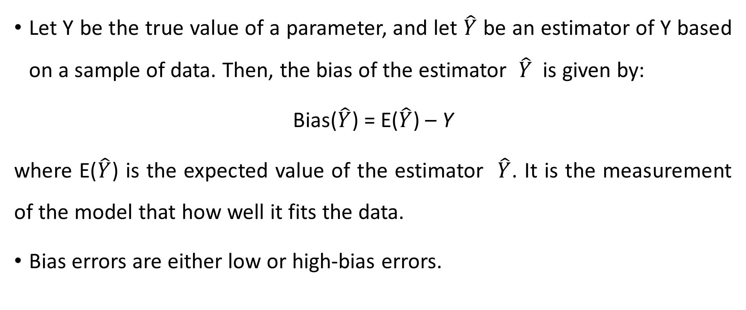
What is Bias?
Let Y be the true value of a parameter, and let $\hat{Y}$ be an estimator of Y based on a sample of data. Then, the bias of the estimator $\hat{Y}$ is given by:
Bias($\hat{Y}$) = E($\hat{Y}$) – Y
where E($\hat{Y}$) is the expected value of the estimator $\hat{Y}$. It is the measurement of the model that how well it fits the data.
Bias errors are either low or high-bias errors.

Slide 8
Low Bias: Low bias value means fewer assumptions are taken to build the target function. In this case, the model will closely match the training dataset.
Some examples of machine learning algorithms with low bias are Decision Trees, k-Nearest Neighbours and Support Vector Machines.
High Bias: High bias value means more assumptions are taken to build the target function. In this case, the model will not match the training dataset closely.
The high-bias model will not be able to capture the dataset trend. It is considered as the underfitting model which has a high error rate. It is due to a very simplified algorithm.
For example, a linear regression model may have a high bias if the data has a non-linear relationship.

Slide 9
Ways to reduce High Bias:
High bias mainly occurs due to a much simple model. Below are some ways to reduce the high bias:
Use a more complex model: like Polynomial regression for non-linear datasets, CNN for image processing, and RNN for sequence learning.
Increase the number of features: By adding more features to train the dataset will increase the complexity of the model.
Reduce Regularization of the model: Regularization techniques such as L1 or L2 regularization can help to prevent overfitting and improve the generalization ability of the model.

Slide 10
What is a Variance Error?
Variance is the measure of spread in data from its mean position.
In machine learning variance is the amount by which the performance of a predictive model changes when it is trained on different subsets of the training data.
More specifically, variance is the variability of the model that how much it is sensitive to another subset of the training dataset. i.e. how much it can adjust on the new subset of the training dataset.

Slide 11
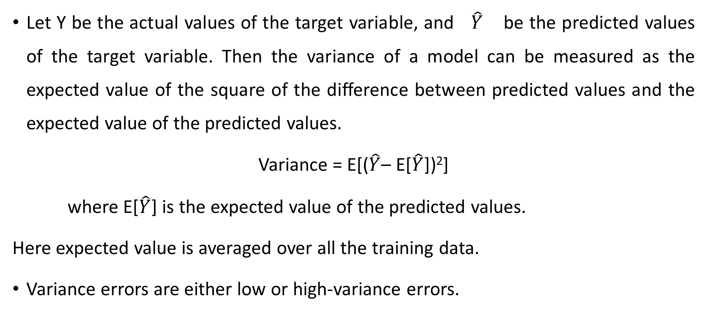
What is a Variance Error?
Let Y be the actual values of the target variable, and $\hat{Y}$ be the predicted values of the target variable. Then the variance of a model can be measured as the expected value of the square of the difference between predicted values and the expected value of the predicted values.
Variance = E[($\hat{Y}$– E[$\hat{Y}$])²]
where E[$\hat{Y}$] is the expected value of the predicted values.
Here expected value is averaged over all the training data.
Variance errors are either low or high-variance errors.

Slide 12
Low variance: Low variance means that the model is less sensitive to changes in the training data and can produce consistent estimates of the target function with different subsets of data from the same distribution. This is the case of underfitting when the model fails to generalize on both training and test data.
High variance: High variance means that the model is very sensitive to changes in the training data and can result in significant changes in the estimate of the target function when trained on different subsets of data from the same distribution. This is the case of overfitting when the model performs well on the training data but poorly on new, unseen test data. It fits the training data too closely that it fails on the new training dataset.

Slide 13
Ways to Reduce High Variance:
Reduce the input features or number of parameters as a model is overfitted.
Do not use a much complex model.
Increase the training data.
Increase the Regularization term.

Slide 14
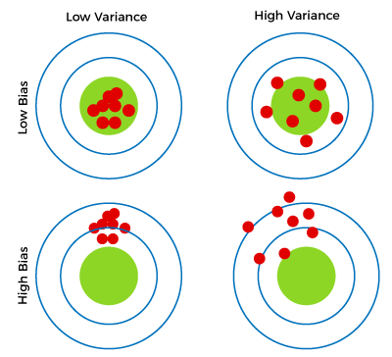
Different Combinations of Bias-Variance
There are four possible combinations of bias and variances, which are represented by the below diagram:

Slide 15
Low-Bias, Low-Variance:
The combination of low bias and low variance shows an ideal machine learning model. However, it is not possible practically.
Low-Bias, High-Variance:
With low bias and high variance, model predictions are inconsistent and accurate on average. This case occurs when the model learns with a large number of parameters and hence leads to an overfitting

Slide 16
High-Bias, Low-Variance:
With High bias and low variance, predictions are consistent but inaccurate on average. This case occurs when a model does not learn well with the training dataset or uses few numbers of the parameter.
It leads to underfitting problems in the model.
High-Bias, High-Variance:
With high bias and high variance, predictions are inconsistent and also inaccurate on average.

Slide 17
Now we know that the ideal case will be Low Bias and Low variance, but in practice, it is not possible. So, we trade off between Bias and variance to achieve a balanced bias and variance.
A model with balanced bias and variance is said to have optimal generalization performance. This means that the model is able to capture the underlying patterns in the data without overfitting or underfitting.
The model is likely to be just complex enough to capture the complexity of the data, but not too complex to overfit the training data. This can happen when the model has been carefully tuned to achieve a good balance between bias and variance, by adjusting the hyperparameters and selecting an appropriate model architecture.

Slide 18
Machine Learning Algorithm | Bias | Variance
Linear Regression | High Bias | Less Variance
Decision Tree | Low Bias | High Variance
Random Forest | Low Bias | High Variance
Bagging | Low Bias | High Variance

Slide 19
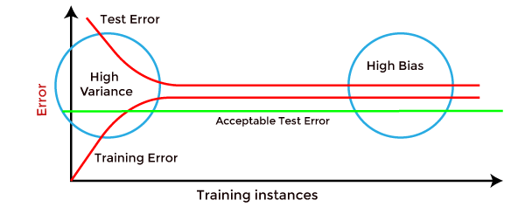
How to identify High variance or High Bias?
High variance can be identified if the model has:
Low training error and high test error.
High Bias can be identified if the model has:
High training error and the test error is almost similar to training error.

Slide 20
Bias-Variance Trade-Off
While building the machine learning model, it is really important to take care of bias and variance in order to avoid overfitting and underfitting in the model. If the model is very simple with fewer parameters, it may have low variance and high bias. Whereas, if the model has a large number of parameters, it will have high variance and low bias. So, it is required to make a balance between bias and variance errors, and this balance between the bias error and variance error is known as the Bias-Variance trade-off.

Slide 21
For an accurate prediction of the model, algorithms need a low variance and low bias. But this is not possible because bias and variance are related to each other:
If we decrease the variance, it will increase the bias.
If we decrease the bias, it will increase the variance.

Slide 22
Bias-Variance trade-off is a central issue in supervised learning. Ideally, we need a model that accurately captures the regularities in training data and simultaneously generalizes well with the unseen dataset. Unfortunately, doing this is not possible simultaneously. Because a high variance algorithm may perform well with training data, but it may lead to overfitting to noisy data. Whereas, high bias algorithm generates a much simple model that may not even capture important regularities in the data. So, we need to find a sweet spot between bias and variance to make an optimal model.
Hence, the Bias-Variance trade-off is about finding the sweet spot to make a balance between bias and variance errors.

Slide 23
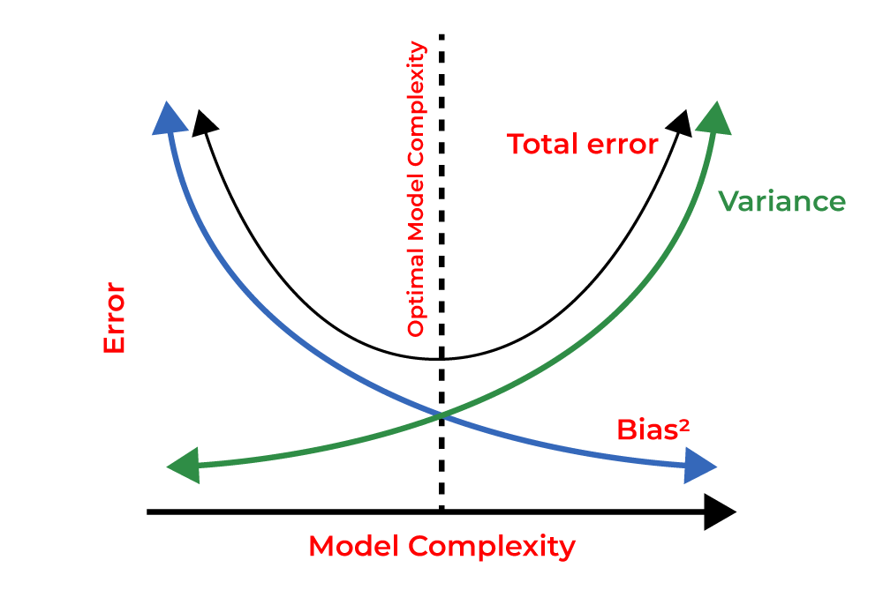

Slide 24
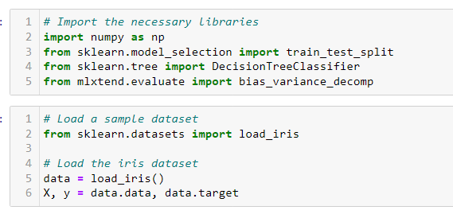
The technique by which we analyze the performance of the machine learning model is known as Bias Variance Decomposition.
Example of Bias Variance Decomposition for classification

Slide 25
